Slide 1

Project Title:Augmented Tour(App)
Proposal and Feasibility Presentation Template
Project By
Abuzar FA14-BSE-178
Muhammad Hamza FA14-BSE-148
Muhammad Sulaiman FA14-BSE-100
Supervised by
Syed Zulqarnain Arif
Department of Computer Science
COMSATS Institute of IT, Abbottabad

Slide 2
Agenda of the Presentation
Introduction
Requirements
Motivation
Scope
Functionalities
Proposed Tools
Project Feasibility
Task for 1st iteration
Conclusion

Slide 3
Motivation
Application for the Tourist is the highly demand of Tourist Agencies.
Application(World Around Me) develop (last year for Tourist win the best application award 2016).
Augmented Tour make possible help in finding places to tourist with very Attractive, Friendly and Effective way.

Slide 4
Brief Introduction
An Augmented Tour is Android Application based on overlaying Tourist Interest point of region from GPS on Live Camera View over Tags via mobile devices.

Slide 5
Scope
App will work dynamically user can add their own point interest.
App is developing only for Abbottabad City.
App will show user point of interest on Live Camera View.
App will work on android operating system.
Location of each region will store manually in database.
App will not work for other city.
App will not support multiple operating system.

Slide 6
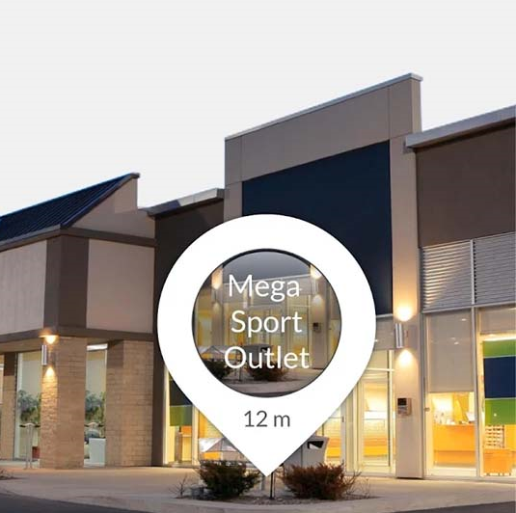
Functionalities
Customer can view information on Live Camera View about their own interest: like Hotels, Hospitals, Banks, Bus Stapps, Mosques and Restaurants.
(Live Camera View Demo)
Application will
show all properties
(distance away from Tourist)
Distance

Slide 7
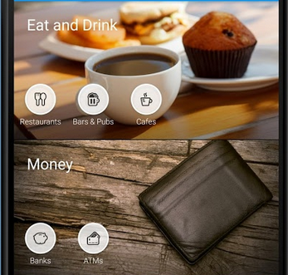
Continue…
Application will display On Live Camera View all the region from GPS in Tag according to the Customer interest.
Customer interest

Slide 8
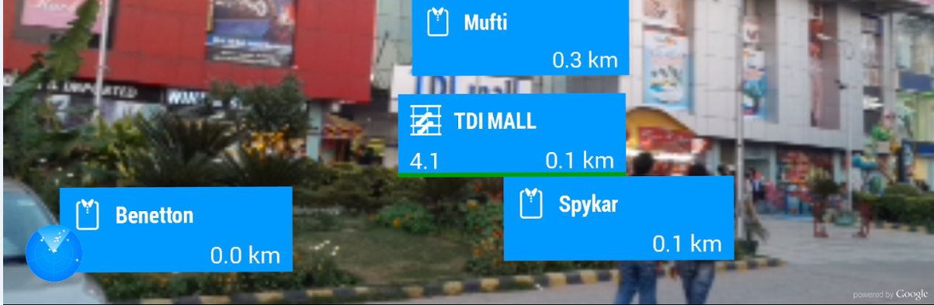
Continue…
Application will display all the events on Camera View that are in the direction of Camera.
Shows Direction

Slide 9
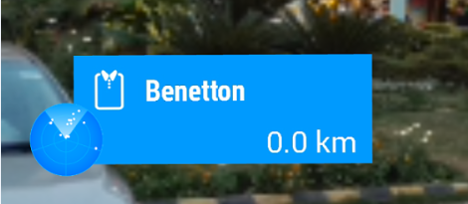
Continue
The application will notify to customer about orientation and change direction of Android Device.
Direction
Available Shops

Slide 10
Proposed Tools/Platform
Operating system: Android
Programming Language: Java
IDE: Android studio
API: ARtoolkit,DriodAR

Slide 11
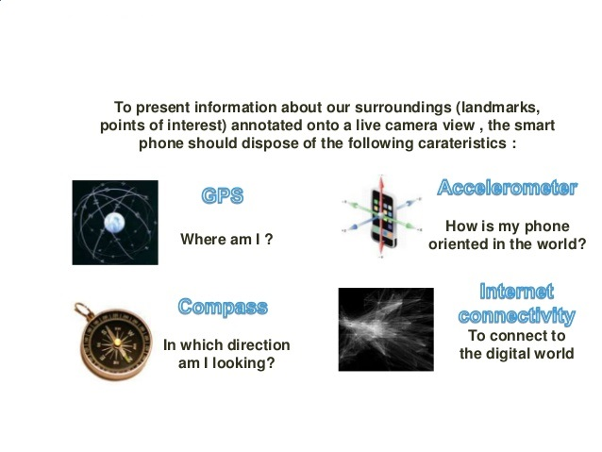
Feasibility
Technical feasibility

Slide 12
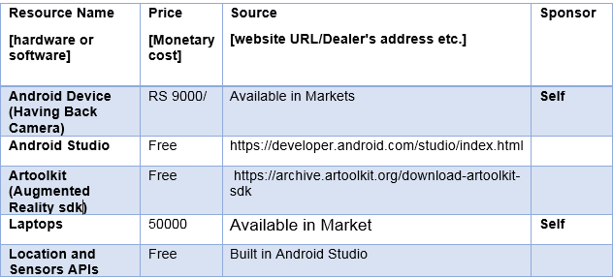
Feasibility
Financial Feasibility: A tabulated information of pricing and source of availability and financing of tools and other resources required for the project.

Slide 13
Feasibility
Resource feasibility: Augmented Reality Libraries and Android Application development tools are easily and freely available on internet.
Libraries:
ARtoolkit
DriodAR
IDE/Languages
Java
Android Studio

Slide 14
Feasibility
Operational feasibility
The proposed system is entirely applicable and operationally feasible.
Location and Sensors APIs(Available in Android Studio)
Recommendation Techniques (Location Base Augmented Reality)
Accelerometer (Available in Android Devices)

Slide 15
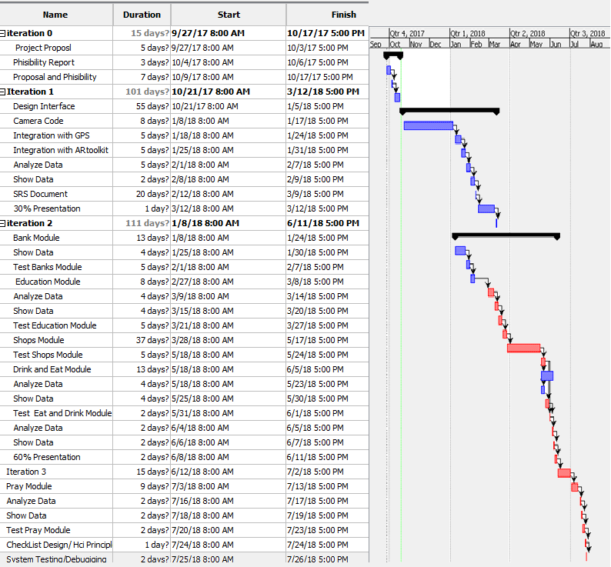
Schedule

Slide 16
Tasks for 1st Iteration (or 30%)
Android app
The front of the application will be developed.
Implementation for accessing Phone Camera.
Recording data from Camera.
Integrating app with GPS.
Integrating Augmented Libraries in application.
Designing Tags for Data.
Showing On interest of Tourist on Live Camera View.
Documentation
Proposal
Feasibility Report
SRS
Design Document
Test Plan

Slide 17
Conclusion
The objective of this presentation is to get approved our project
according to it’s feasibility study considering the all points
mentioned above.

